Slide 1
Newton-Cotes Integration Formulas

Slide 2
Newton-Cotes Integration Formulas are numerical integration techniques that approximate the definite integral of a function using polynomials passing through equally spaced points.
These formulas are a family of rules derived from interpolating polynomials.

Slide 3
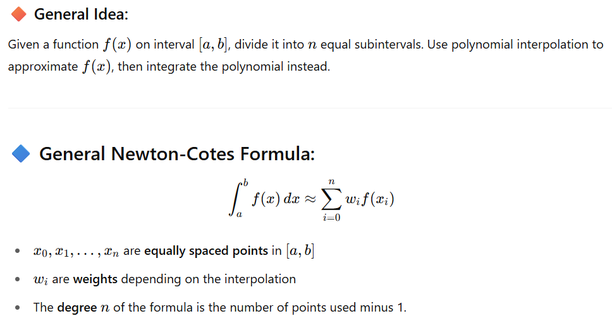

Slide 4
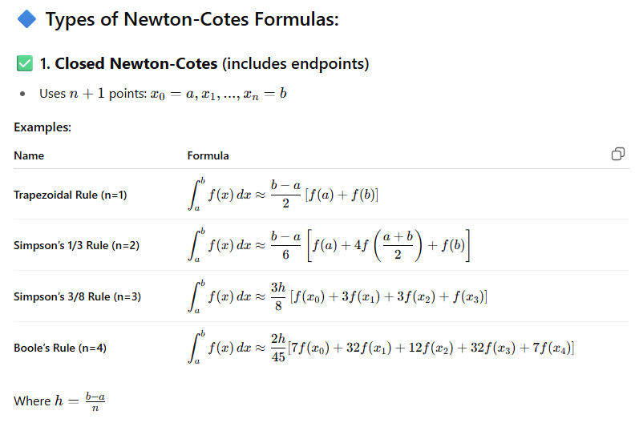

Slide 5
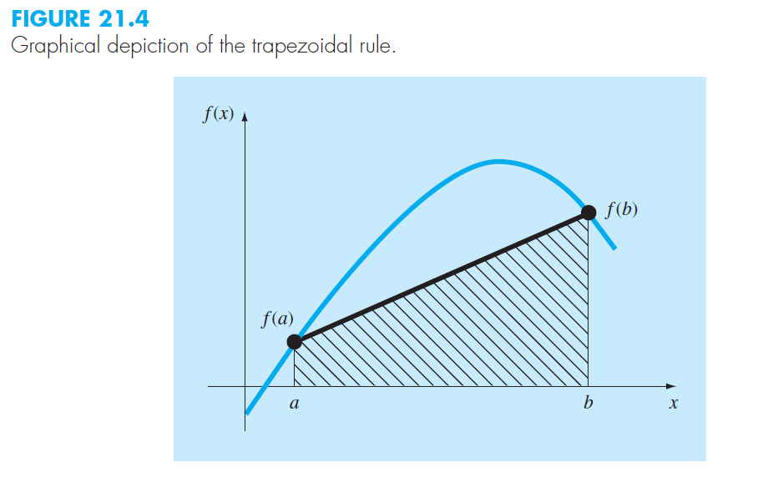

Slide 6
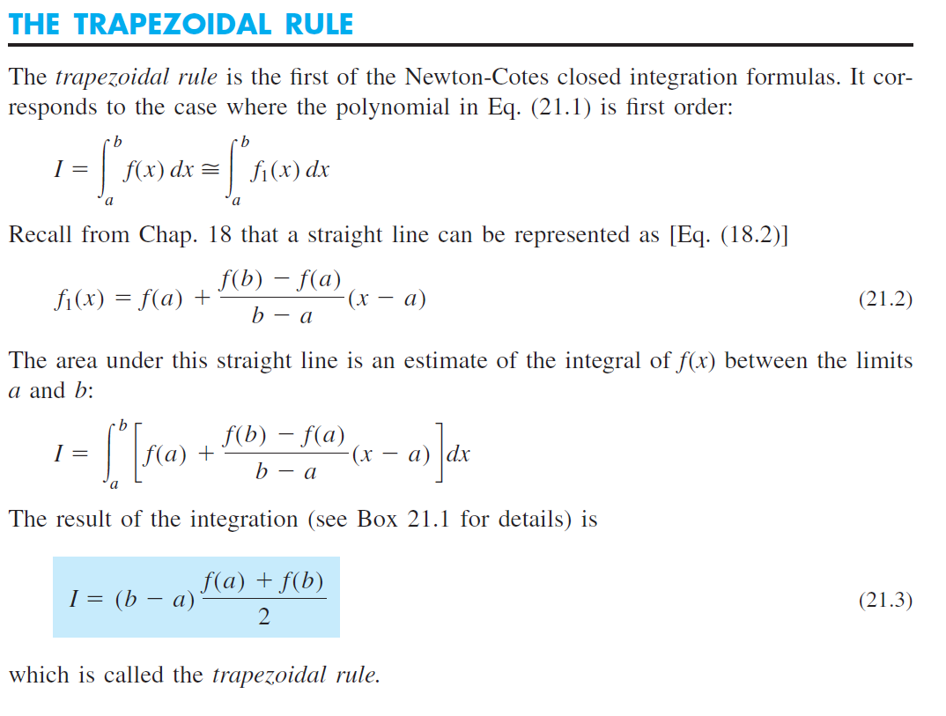

Slide 7
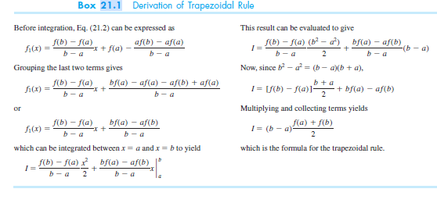

Slide 8
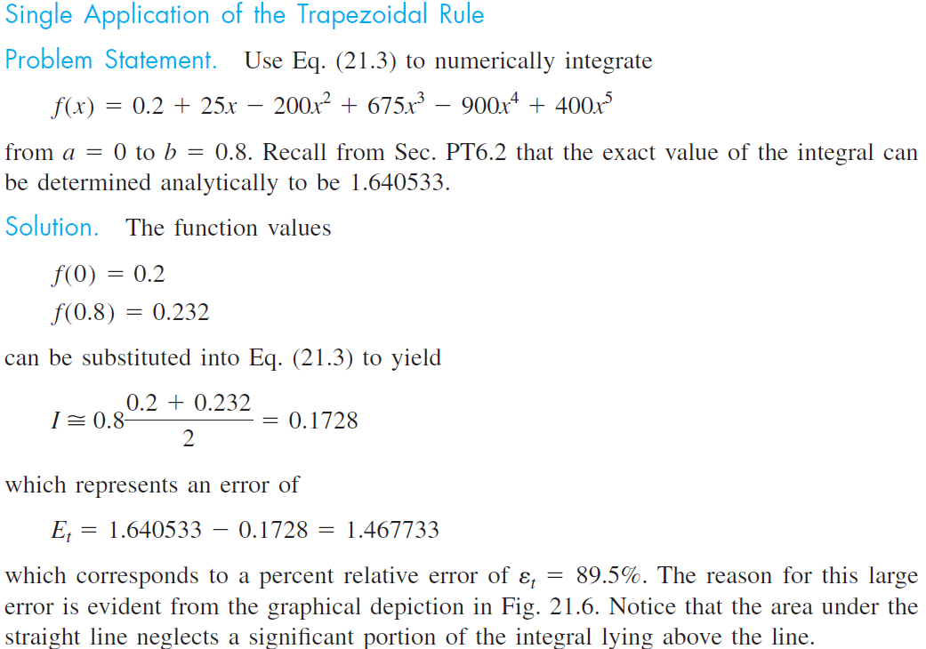

Slide 9
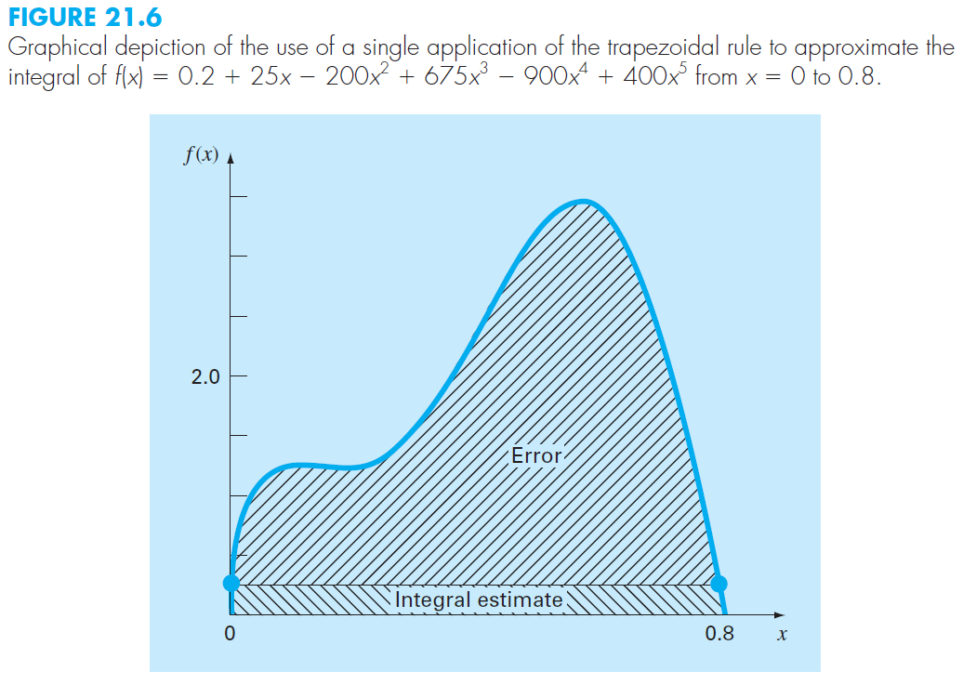

Slide 11
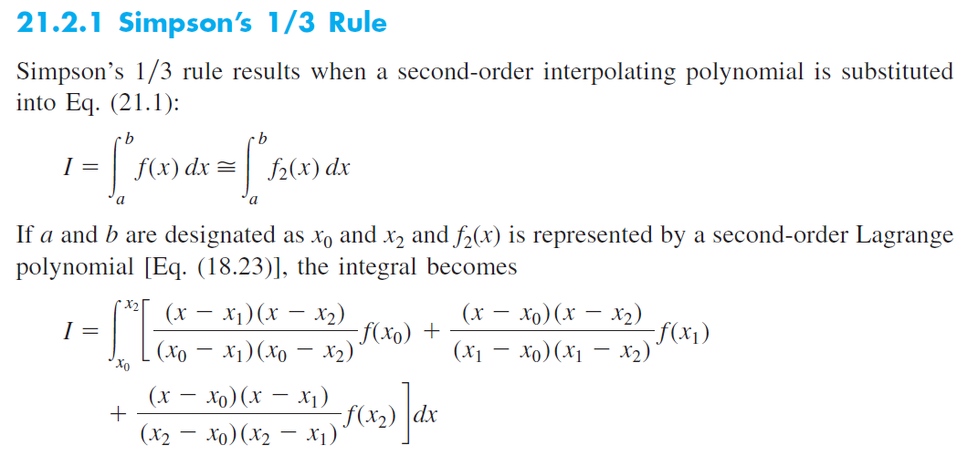

Slide 13
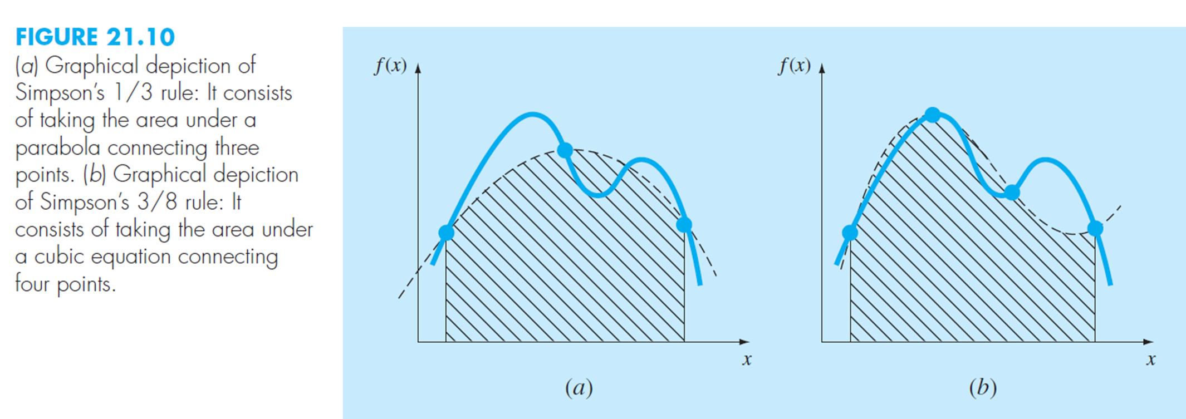

Slide 14
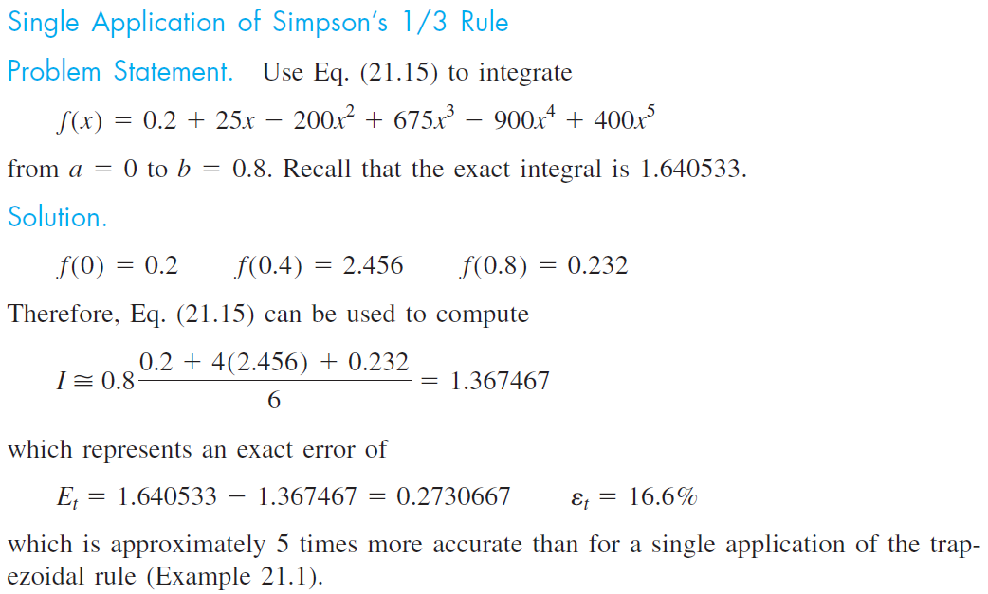

Slide 15
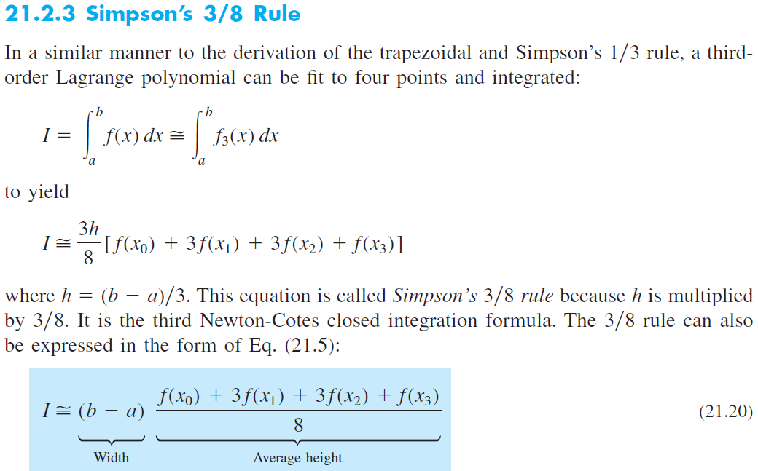

Slide 16
